Slide 1
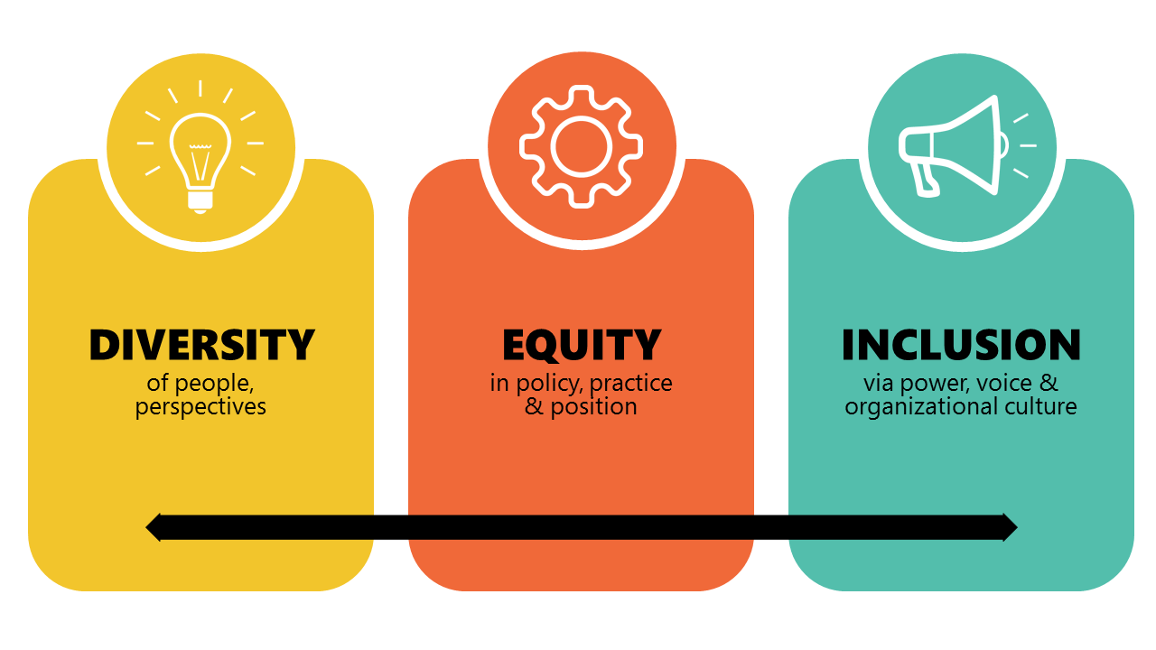
A Vision for Improving Diversity, Equity, Inclusion, and Belonging at Yale

Slide 2
The Yale Mission
“Yale is committed to improving the world today and for future generations through outstanding research and scholarship, education, preservation, and practice. Yale educates aspiring leaders worldwide who serve all sectors of society. We carry out this mission through the free exchange of ideas in an ethical, interdependent, and diverse community of faculty, staff, students, and alumni.”
Student demographics are changing to better reflect national demographics.
Staff demographics have also changed, although not as much.
Faculty demographics are nearly stagnant over the past two decades.

Slide 3
The Connection of Diversity and Excellence
Improving faculty diversity is expected to impact learning and research at Yale and beyond
Increases student retention and persistence in fields of study
Research shows more diverse faculty tend to increase global issues considered for research and teaching. Students exposed to global issues are more likely to engage (higher attendance and achievement) and are twice as likely to take personal social action on such issues after graduation
Education within a diverse setting better prepares students to be good citizens in an increasingly complex, pluralistic society
Decades of research by organizational scientists, psychologists, sociologists, economists and demographers show that socially diverse groups are more innovative than homogeneous groups

Slide 4
Diversity, Inclusion, and Equity
What are we looking for to improve faculty diversity?
People with differing opinions, social experiences, political and religious beliefs, heritages and life experiences is what improving diversity adds to our research, teaching and service
Increasing the range of racial, ethnic, dimensions of dis/ability, socioeconomic, geographic, gender, gender identity, sexual orientation, veteran status and national origins acknowledges societal forces

Slide 5
From the National Academies Press
“…we must continue to drive bias, discrimination, and harassment out of our institutions and society. Despite decades of research, funding, and programs dedicated to increasing the representation of women in science, engineering, technology, mathematics and medicine, the numbers, particularly in leadership roles, have remained low or stagnant in many fields, particularly among women of color.”
“The bulk of evidence indicates that underrepresentation of women in STEMM is driven by a wide range of structural, cultural, and institutional patterns of bias, discrimination, and inequity that do not affect men of comparable ability and training…”
“These factors are often experienced more overtly and intensely by women of intersecting identities, such as women of color, women with disabilities, and LGBTQIA women”

Slide 6
The Challenge of Achieving Diversity
Why is this not the “natural” picture of academic faculty?
Why focus on diversity rather than inclusion?
Focuses on labeling/bucketing
Emphasizes differences rather than commonalities
Defiance/backlash
Success can be counted as assimilation, not pluralism
Exhaustion of ideas, people
Lack of success over decades of trying

Slide 7
Studies Indicate the Problematic Cultural Patterns Limiting Inclusion and Diversity
You cannot simply launch programs and expect results.
Leaders still underestimate the challenges BIPOCs face.

Slide 8
Comments or Questions?

Slide 9
What Change Is Indicated/Warranted?
Studies find that the leading causes for barriers to improvement of faculty diversity are:
Belief in pipeline paucity even though it does not fully explain the lack of progress (U. of California studies)
A sense of isolation for underrepresented faculty resulting from or leading to
Lack of mentoring
Devaluation of “minority research”, particularly in strongly interdisciplinary fields
The “token hire” misconception among URM faculty
Biases in tenure and promotion evaluations

Slide 10
One Example Set: Cultural Changes Needed Around Recruitment
“I totally support diversity and inclusion, but the pipeline in this field is too small to do it.”
“How are we supposed to balance diversity versus excellence?”
“We don’t have a problem with hiring women - we, like any other department, would jump at the chance to hire Professor xxxx.”
“Where is the evidence of structural racism in any of our past actions?”
“I have never seen any instance of racism or any other form of bias in this department or among my faculty colleagues.”
Pipeline paucity does not fully explain the lack of progress in STEM fields (U. of California studies)
Diversity increases innovation, inclusion improves productivity and makes diversity possible.
Who are the numbers 2 and 3 and 4… women on that list?
Numerous studies show this evidence across numerous universities and fields – why are we different?
Minority and female faculty also play an important role in listening to issues that underrepresented students are unlikely to bring up to other faculty that they may not identify with.

Slide 11
The Challenge of Achieving Diversity
Why is this not the “natural” picture of academic faculty?
Most people in positions of influence think they do not suffer from bias
Recent studies from psychologists and reports from URM’s show bias and how it works in the workplace
Lack of awareness of how systemic bias in a cultural and historic context
Systemic bias today results from systemic bias/racism of the past – hiding the connection is part of the system
We are all aware of unusual career paths resulting in remarkable achievements – yet we remain risk averse
Insistence on use of biased measures of productivity without corresponding measures of value/worth

Slide 12
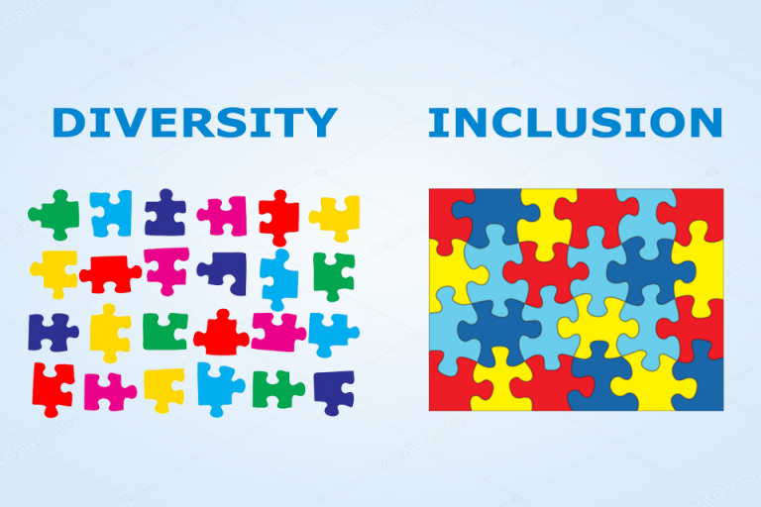
Some Findings from the President’s Committee on Diversity, Inclusion and Belonging
Strengthen inclusion and a sense of belonging

Slide 13
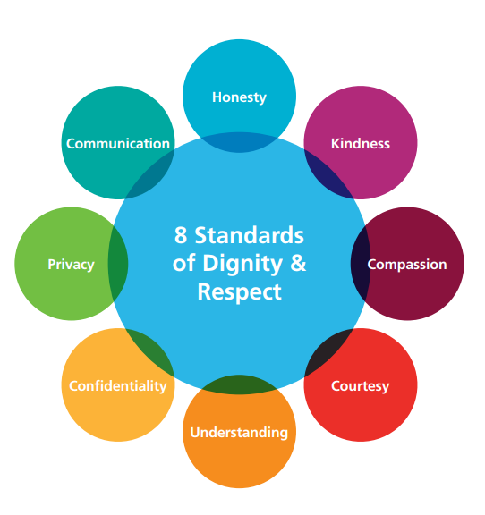
Some Findings from the President’s Committee on Diversity, Inclusion and Belonging
Need a work culture of greater respect

Slide 14
Comments or Questions?

Slide 15
Focus of the Work Ahead
Faculty diversity efforts are the greatest need, but diversification of campus community should be a goal
Review and adopt a framework for assessment
Deepen a culture of respect and connection
Articulate, promote, and socialize DEI and belonging in fulfilling the University’s mission
All academic and administrative units should develop local DEI and belonging plans with specific direction to address the needs of BIPOC staff, faculty and students

Slide 16
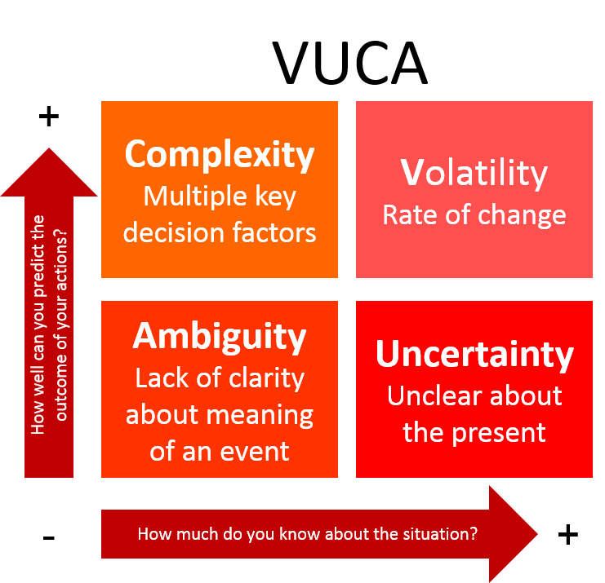
Effective Strategies for Change
Avoid the bias to undue action – Heidi Brooks, Yale SOM
“Reflect on your own culture and power dynamics and create a long-term plan for impact”

Slide 17
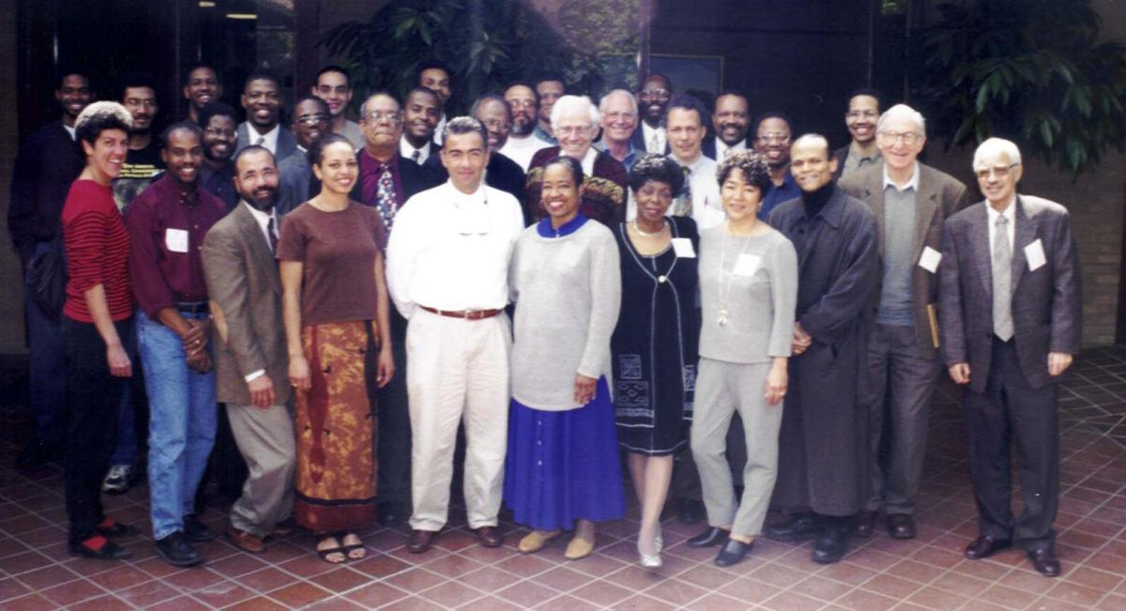
Change Can Be Rapid

Slide 18
Effective Strategies for Change
Lean into climate surveys and departmental self-assessment (we can help but look to your peers as well)
Leaders need to lead
Particularly on hard discussions about race, gender, inclusion
Leaders set the culture for deciding on your core values
Empower ugrad/grad students/staff/Asst. Profs to dialogue
Restructure your committees
Diversify representation
Seek to engage groups most impacted by decisions of a committee
Broaden the leadership pool

Slide 19
Examples of Best Practices for Change
Expand networks for recruitment, advice, and scholarship
Faculty search and graduate recruiting committee chairs and members should reach out to colleagues at institutions that have diverse faculty and students to identify high-potential female and underrepresented minority candidates
Advertise broadly, including to interest groups with diverse faculty audiences
Use outreach efforts to promote Yale’s interest
Review and revise policies that affect equity and inclusion
Look particularly at means of communication – promote transparency
Distribute decision-making as much as feasible – establish a climate committee
Work to recognize and acknowledge contributions of everyone in your dept
Keep to plans for which you have a means of assessment of progress compared to expectations and accountability for progress.

